Slide 1

Image mosaic
Group 7

Slide 2
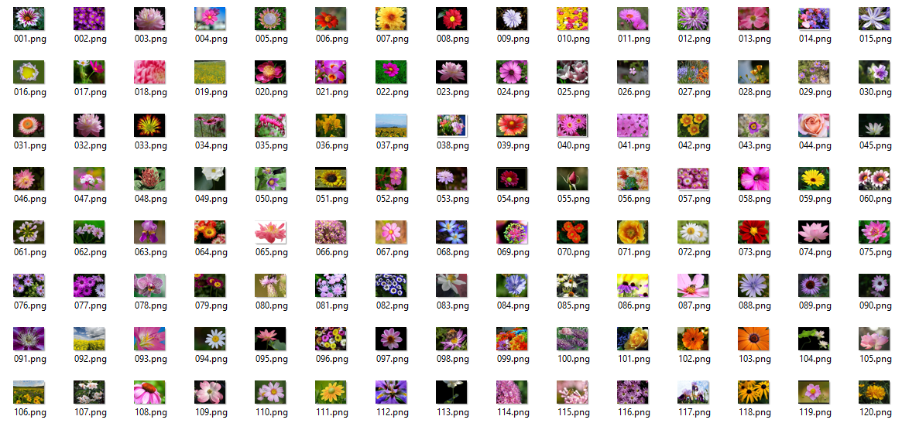
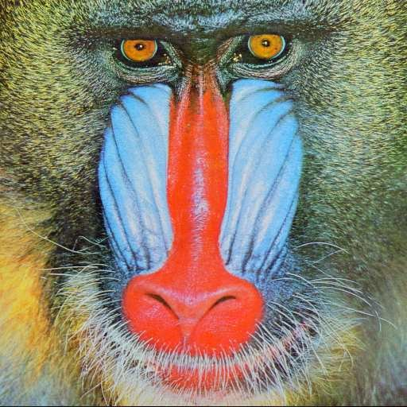
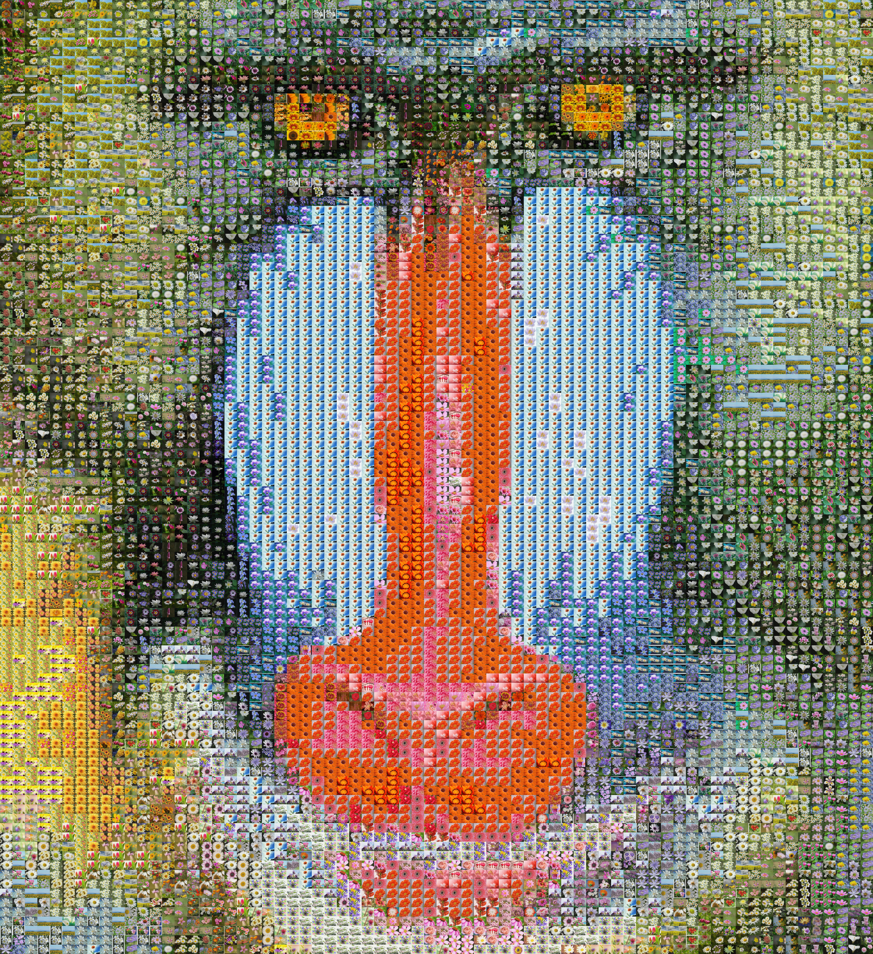
Goal
+
=
Set of images (tiles)
Target image
Mosaic image

Slide 3
Algorithm
Creating Cells
Deciding on the number of tiles
Dividing the target image accordingly
Selecting tiles
With or without color corrolation
Color-averaging techniques
Color correction
Decide on correction factor
improve the quality of the mosaic image

Slide 4
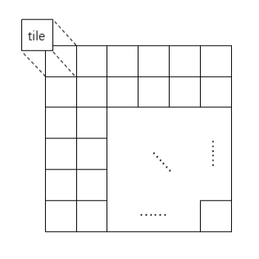
Dividing the target image into cells
Target Image Width
Cell Width =
Number of tiles across
Cell Width * Tile height
Cell Height =
Tile width
Target Image Height
Tiles down =
Cell height

Slide 5
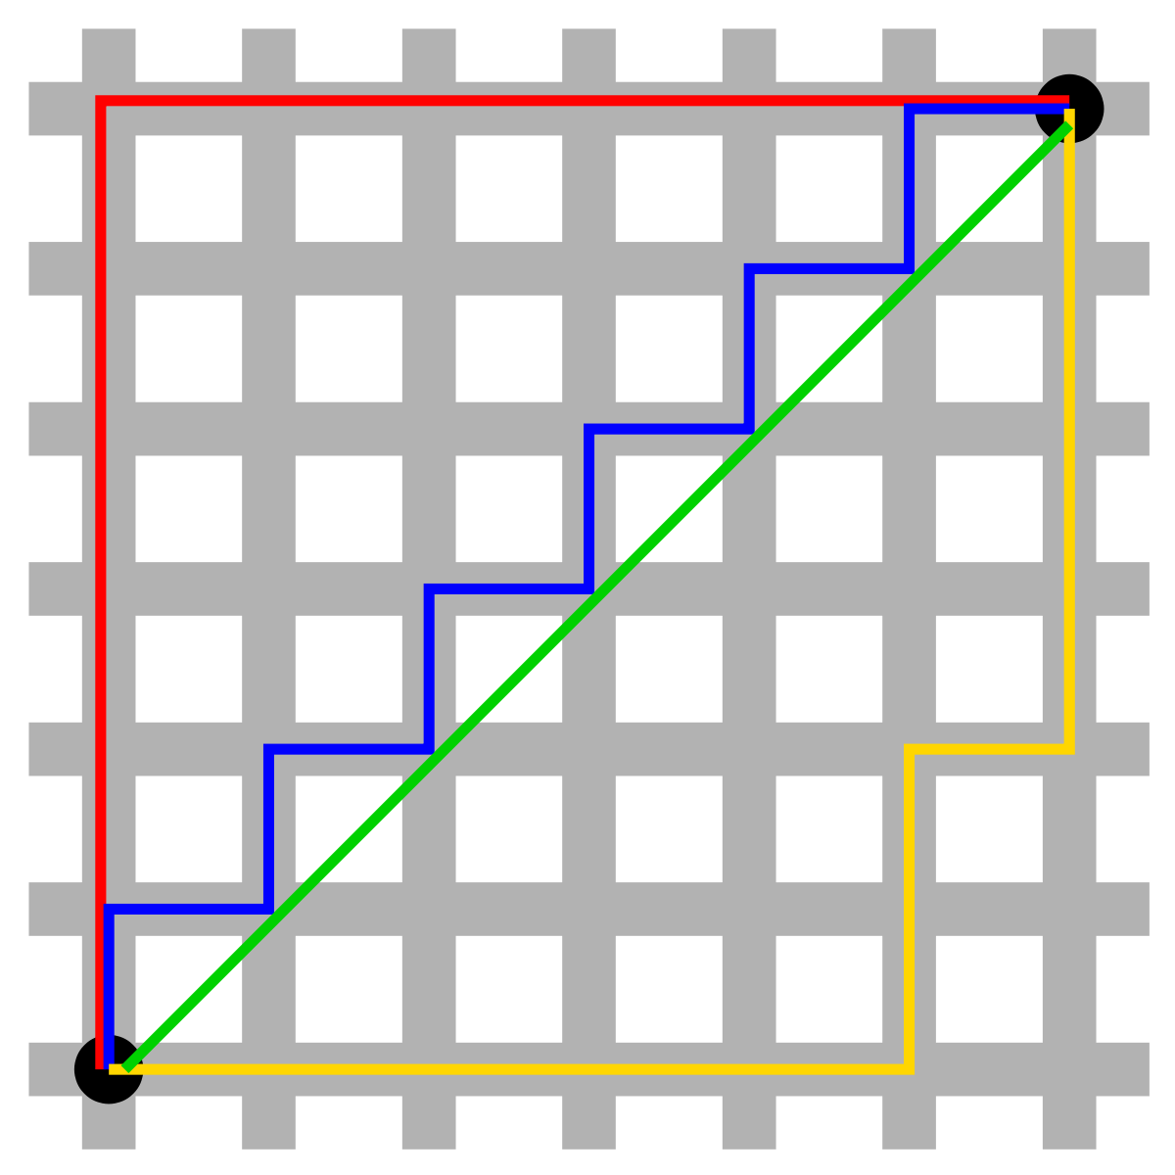
Manhattan distance
Captures the differences between each dimension.
May not be the shortest distance.

Slide 6
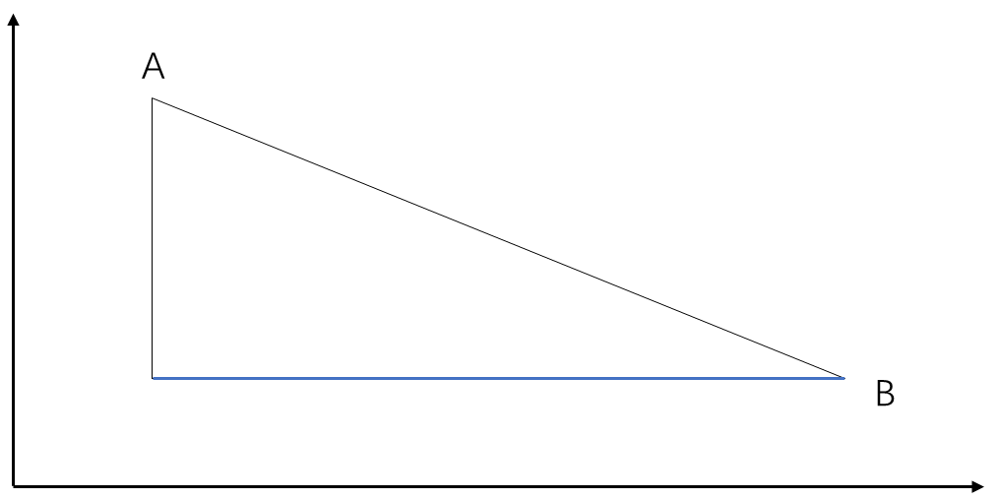
CHEbyshev distance
Captures the differences between each dimension.
More computationally complex. (calculating the max)
More sensitive to subtle differences.

Slide 7
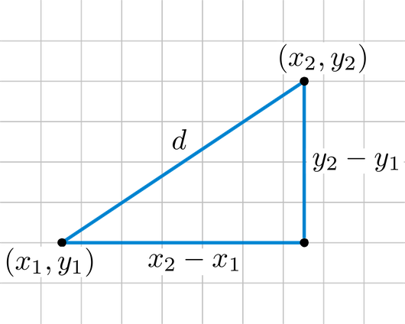
eUCLIDEAN distance
Intuitive and easy to understand.
Widely applicable in most distance measurement tasks.
Shorest distance.
Sensitive to the outliers.
Complexity increases when size of the data is big.

Slide 8
Color Correction
New Tile color = α * Original image color + (1 - α) * Tile color
(This blending is performed independently for the Red, Green, and Blue channels of the image.)
The value of α represents a weight factor that determines the influence of the original image color on the color of the tiles.
α ranges between 0 and 1, with higher values indicating a stronger influence of the original image color.
The choice of α determines the degree of color correction applied to the tile, allowing the control of intensity of the correction.

Slide 9
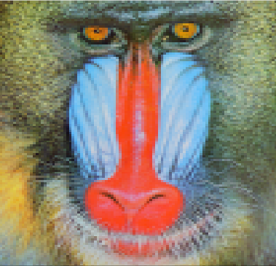
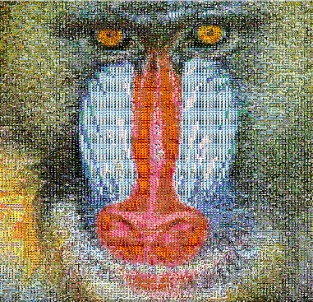
Color Correction
α = 1
If α = 1, it means that the color of the original image is fully preserved and there is color correction at maximum level.
If α = 0, it means that the color of the original image is not taken into consideration, and the color of the tiles is used as is without any color correction
α = 0

Slide 10
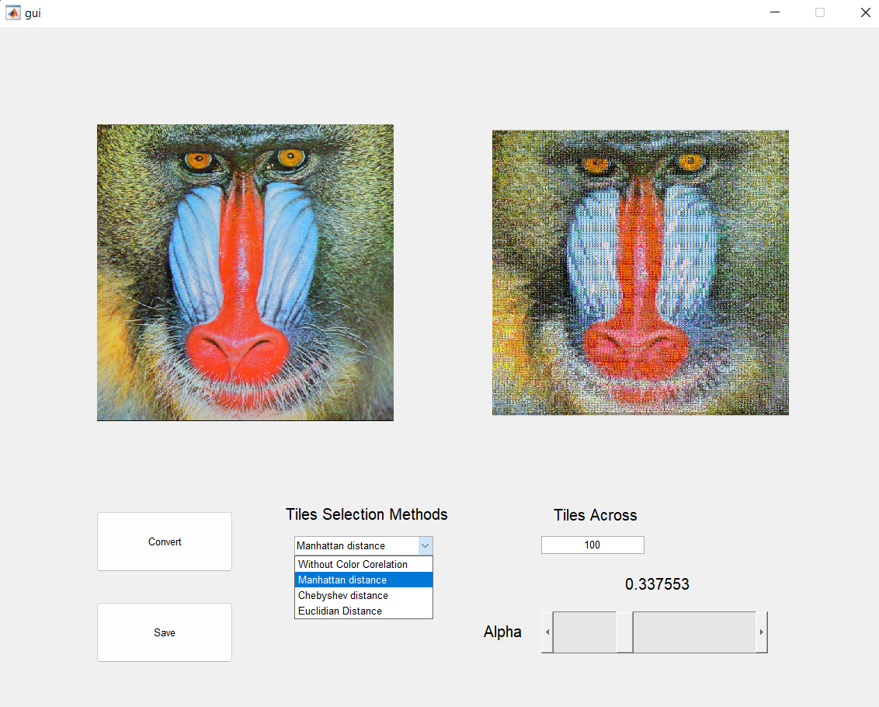
GUI

Slide 11
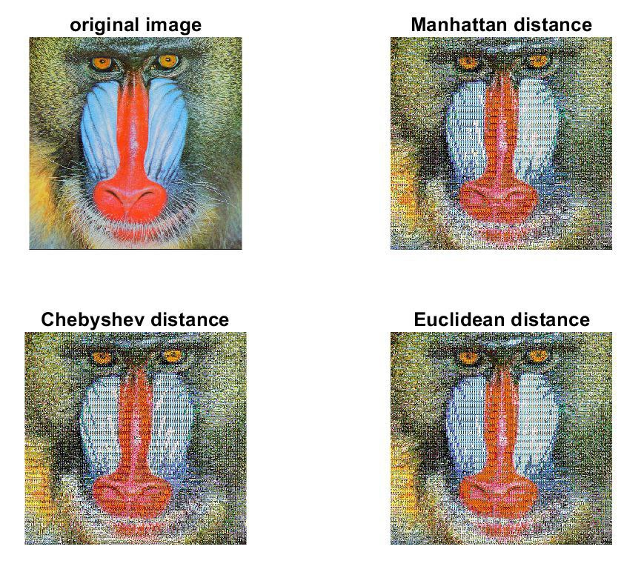
RESULTS

Slide 12
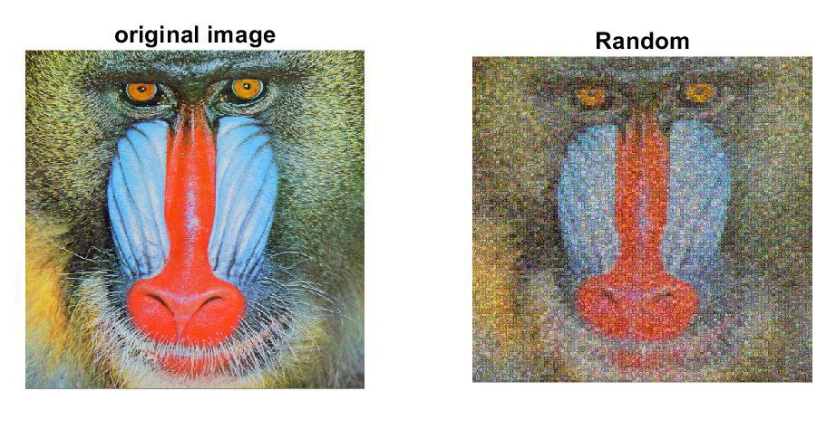
Results

Slide 13
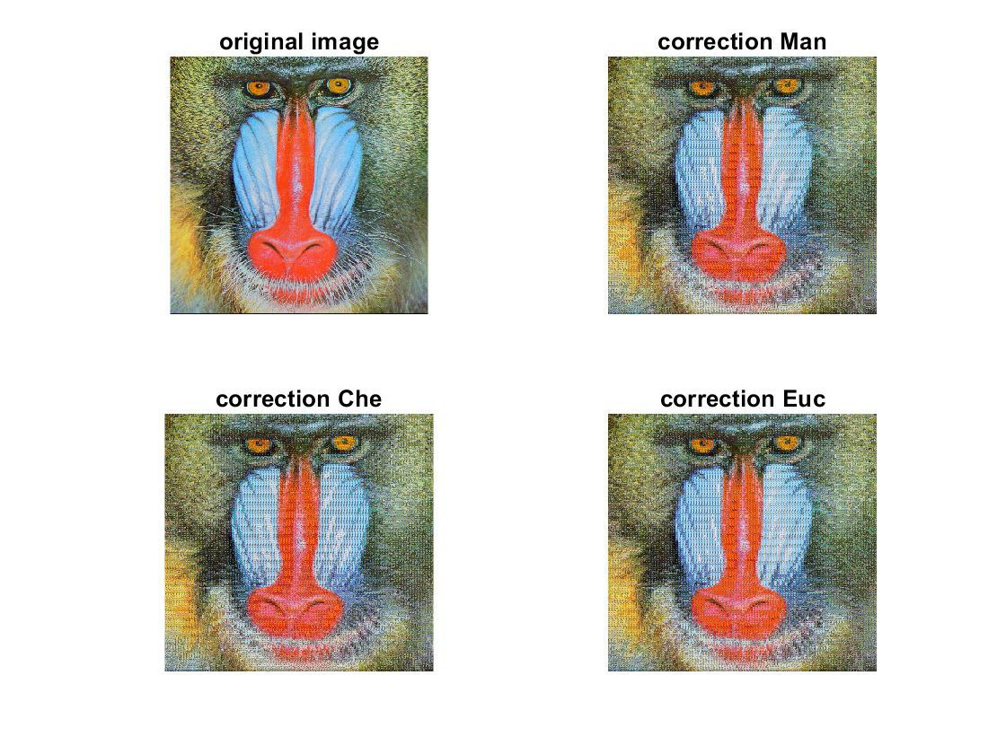
RESULTS

Slide 14
Conclusion
Image mosaic was implemented in MATLAB.
Color correlation has better result than random.
Color Correction further enhanced the quality of image mosaic.
Overall, high quality image was obtained on different target images.

Slide 15
Questions?

